Slide 1
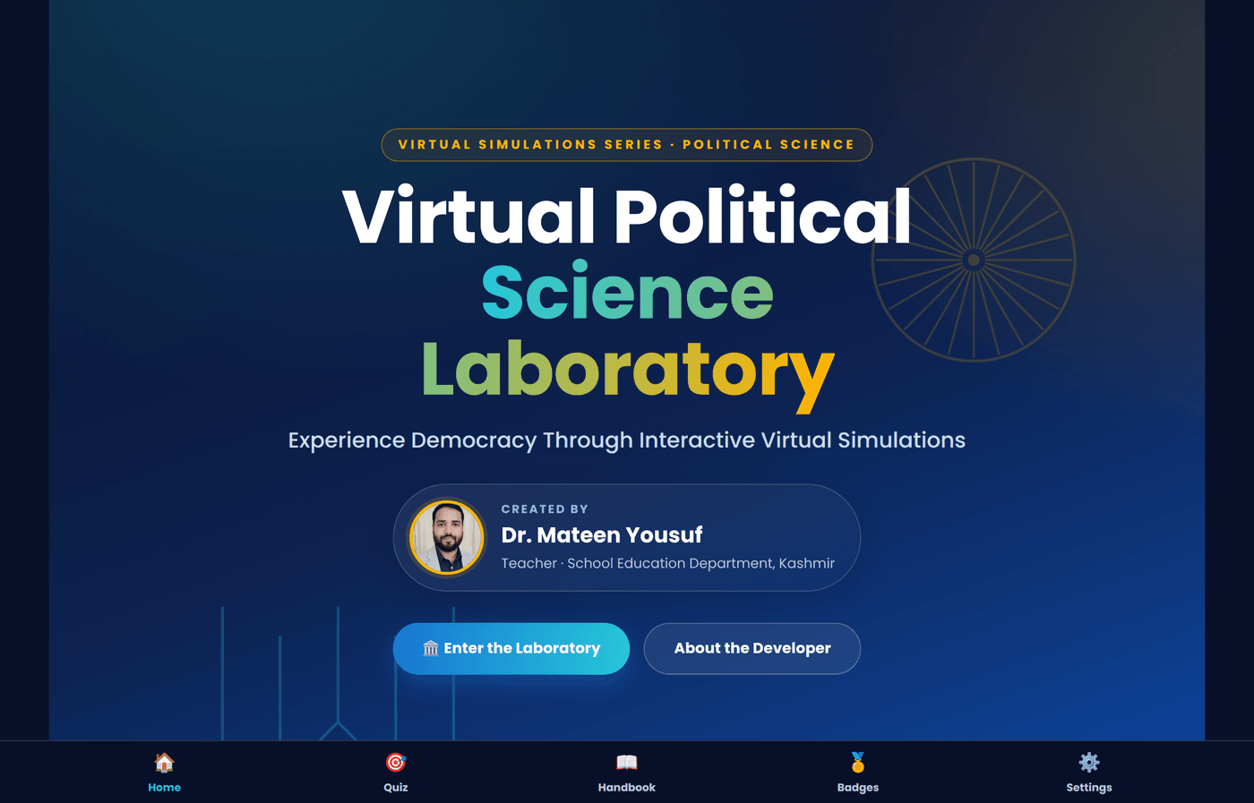

VIRTUAL SIMULATIONS SERIES · POLITICAL SCIENCE
Virtual Political Science Laboratory
Experience Democracy Through Interactive Virtual Simulations
CREATED BY
Dr. Mateen Yousuf
Teacher · School Education Department, Kashmir
100% Offline PWA · No Login · 10 Interactive Simulations
VIRTUAL POLITICAL SCIENCE LABORATORY
01 / 22

Slide 2
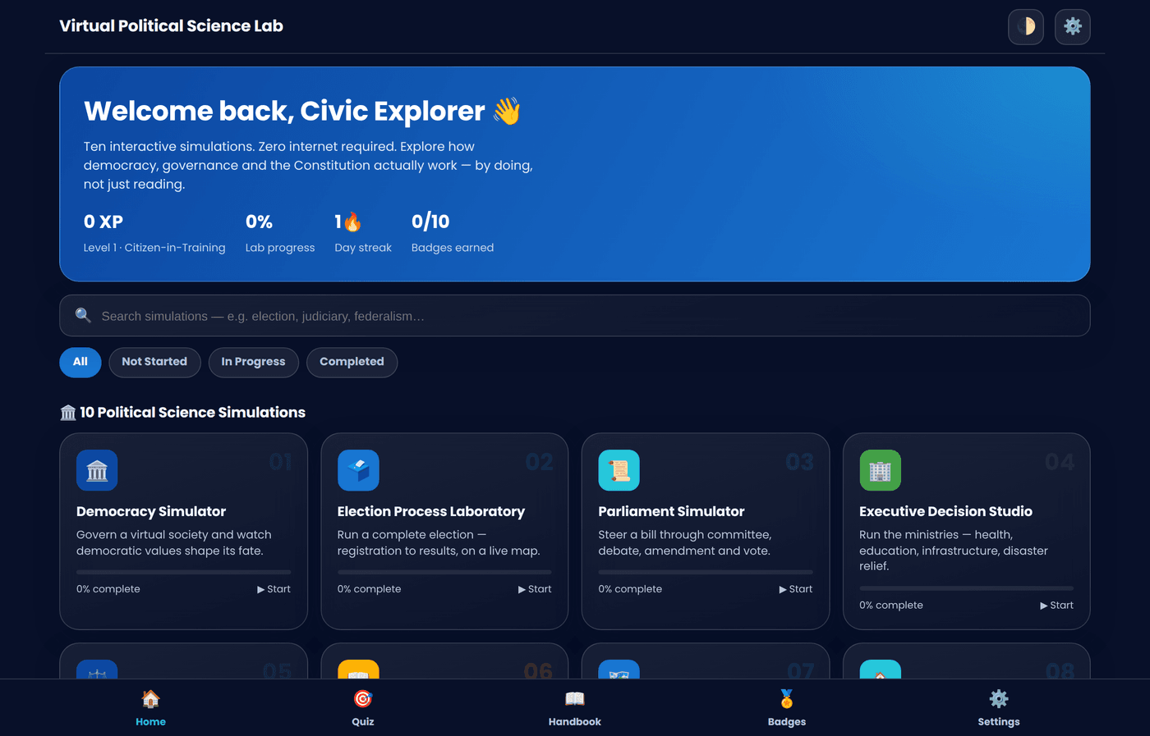
ABOUT THE LABORATORY
What Is This App?
A hands-on civic education platform where students don't just read about democracy — they run it, from elections to lawmaking.
🏛️
10 Full Simulations
Democracy, elections, parliament, judiciary, federalism and more — each a genuine working model, not a slideshow.
📡
100% Offline PWA
Installs like a native app and runs with zero internet connection, backend, or login.
🎮
Gamified Learning
XP, civic levels, badges and streaks turn constitutional literacy into an engaging habit.
📚
Built-in References
An interactive Constitution Handbook and illustrated Glossary support every simulation.
VIRTUAL POLITICAL SCIENCE LABORATORY
02 / 22

Slide 3
BUILT FOR THE CLASSROOM
Who Uses It — and the Design Language
One consistent, premium civic-interface design system across every screen and simulation.
WHO IT'S FOR
COLOR PALETTE
● Classes VI–XII
● Teachers
● DIET Faculty
● B.Ed. Colleges
● Civics Clubs
● Smart Classrooms
Deep Blue
Primary Blue
Cyan
Emerald Green
Gold / Amber
● Competitive Exam Aspirants
VISUAL MOTIF
Glassmorphism cards on a deep-navy government-inspired backdrop
Rounded, icon-led components with soft gradients and shadows
Full Light & Dark theme support, switchable anytime
Consistent 5-tab structure across all 10 simulations
VIRTUAL POLITICAL SCIENCE LABORATORY
03 / 22

Slide 4
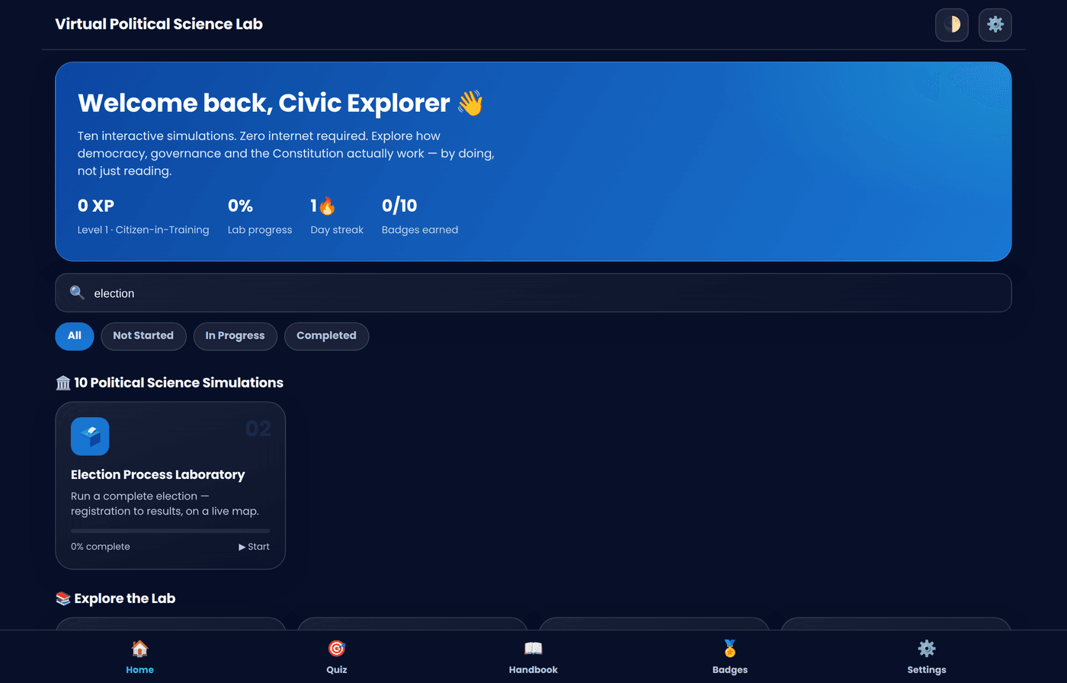
GETTING STARTED
How to Use the Laboratory
Five simple steps take a student from opening the app to a completed, quizzed, badge-earning simulation.
1
Open & Install
Launch the offline PWA — install it to a home screen or desktop for one-tap, no-internet access.
2
Enter the Lab
Tap “Enter the Laboratory” from the animated title screen to reach the Home Dashboard.
3
Pick a Simulation
Browse, search, or filter 10 simulation cards by progress — new, in-progress, or completed.
4
Work the 5 Tabs
Move through Overview → Simulate → Data & Notes → Quiz → Summary at your own pace.
5
Track Your Growth
Earn XP, badges and civic levels — revisit Quiz Centre, Handbook or Glossary anytime.
VIRTUAL POLITICAL SCIENCE LABORATORY
04 / 22

Slide 5
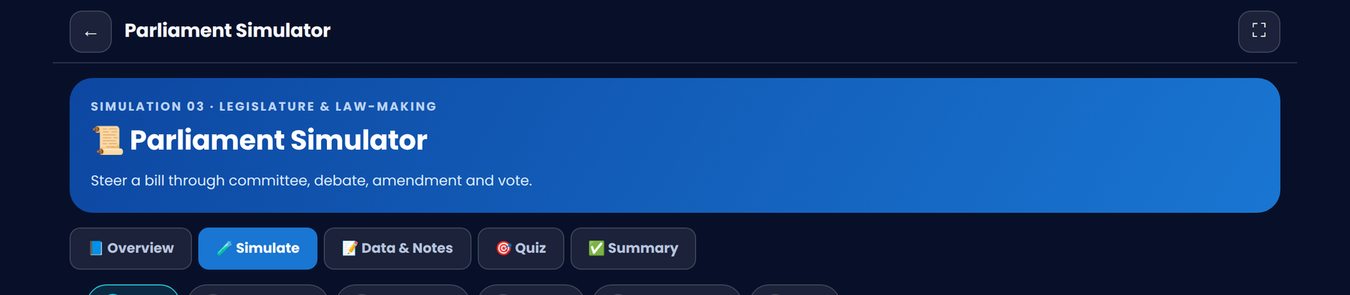
EVERY SIMULATION, EXPLAINED ONCE
Anatomy of a Simulation
All 10 simulations share the same five-tab structure — learn it once, and you can navigate every module.
📘
🧪
📝
🎯
✅
Overview
Simulate
Data & Notes
Quiz
Summary
Objectives, background concepts, constitutional principles, real-life relevance, misconceptions & facts.
The interactive core — sliders, decision panels, steppers, live charts and outcome analysis.
Record and export your own observations as you experiment with the simulation.
A shuffled, instantly-graded mini quiz with explanations — scores are saved automatically.
A wrap-up plus a one-tap “Mark Complete” to bank XP and progress toward badges.
VIRTUAL POLITICAL SCIENCE LABORATORY
05 / 22

Slide 6
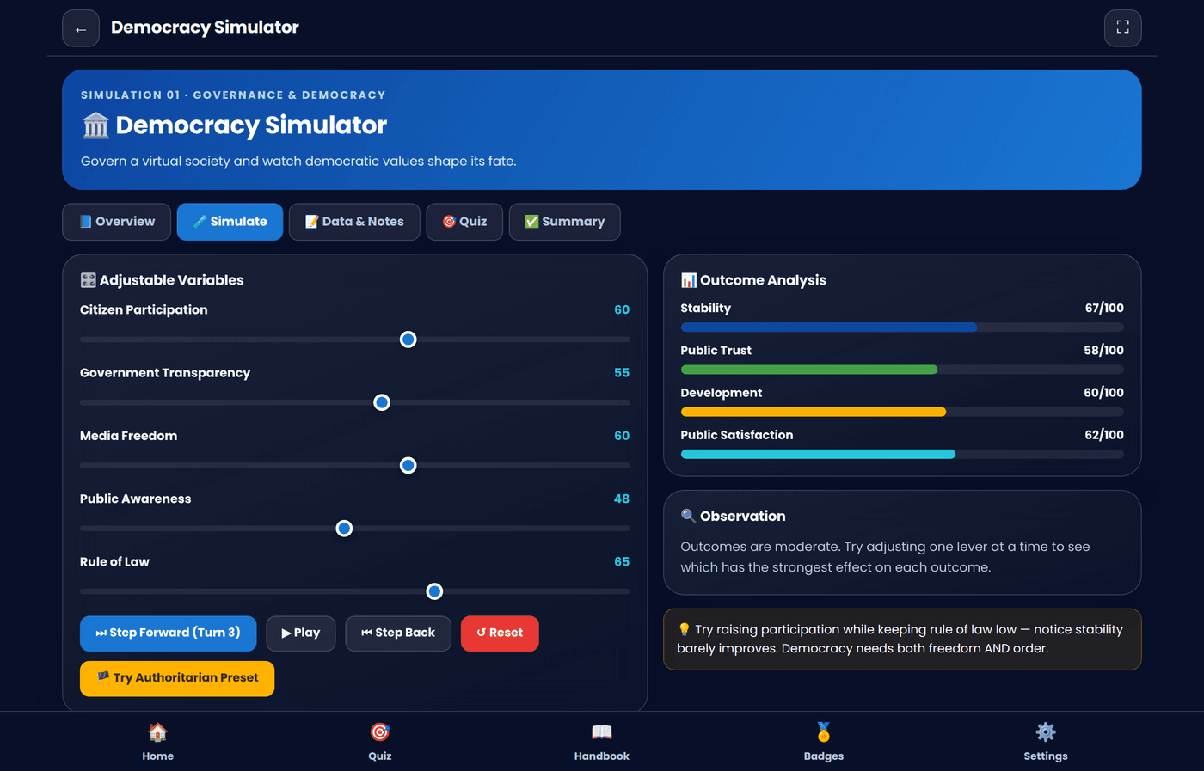
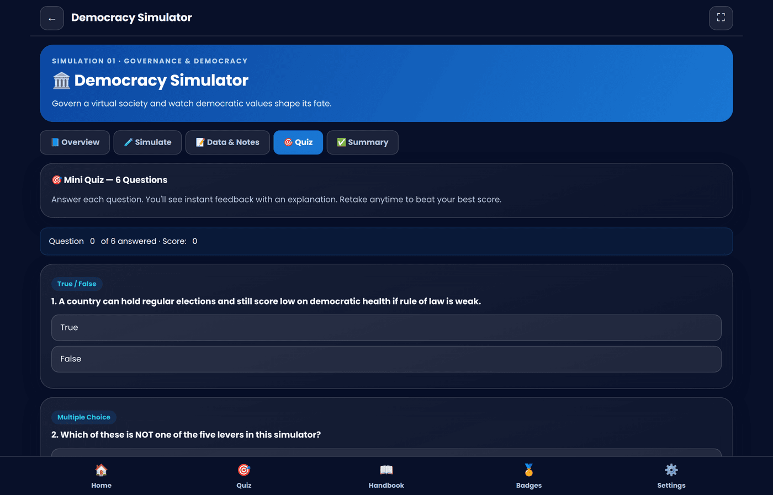
SIMULATION 01 · GOVERNANCE & DEMOCRACY
🏛️
Democracy Simulator
Create and govern a virtual society — then watch democratic values shape its fate.
HOW IT WORKS
Adjust 5 live sliders: participation, transparency, media freedom, awareness & rule of law
Watch stability, trust, development & satisfaction update in real time
Step turn-by-turn and watch outcomes plotted on a live trend chart
Try the “Authoritarian Preset” to compare governance styles directly
VIRTUAL POLITICAL SCIENCE LABORATORY
06 / 22

Slide 7
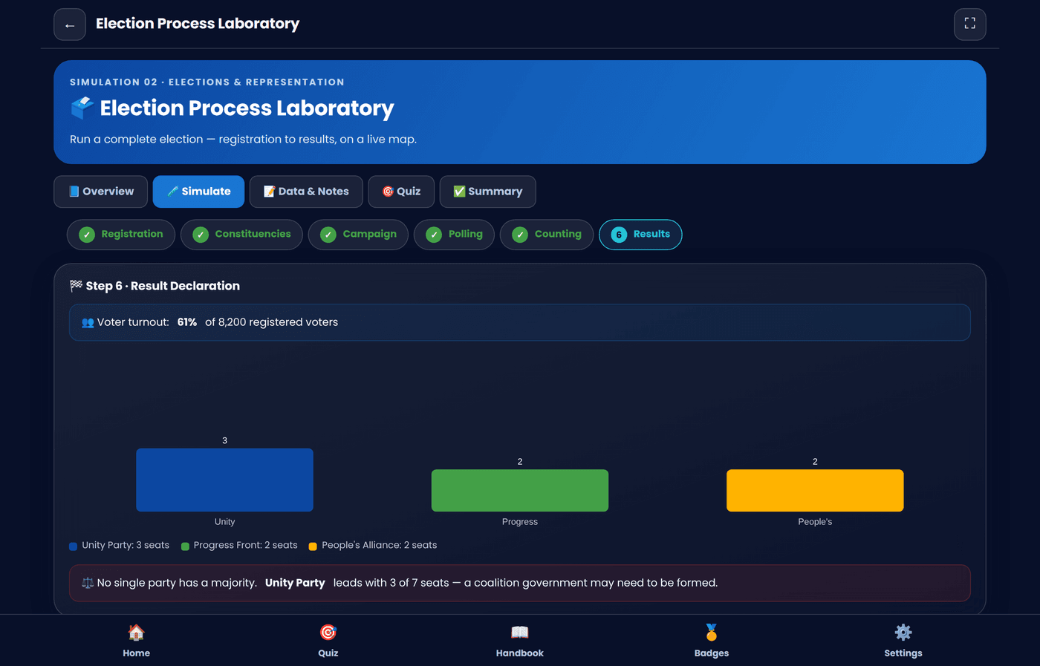
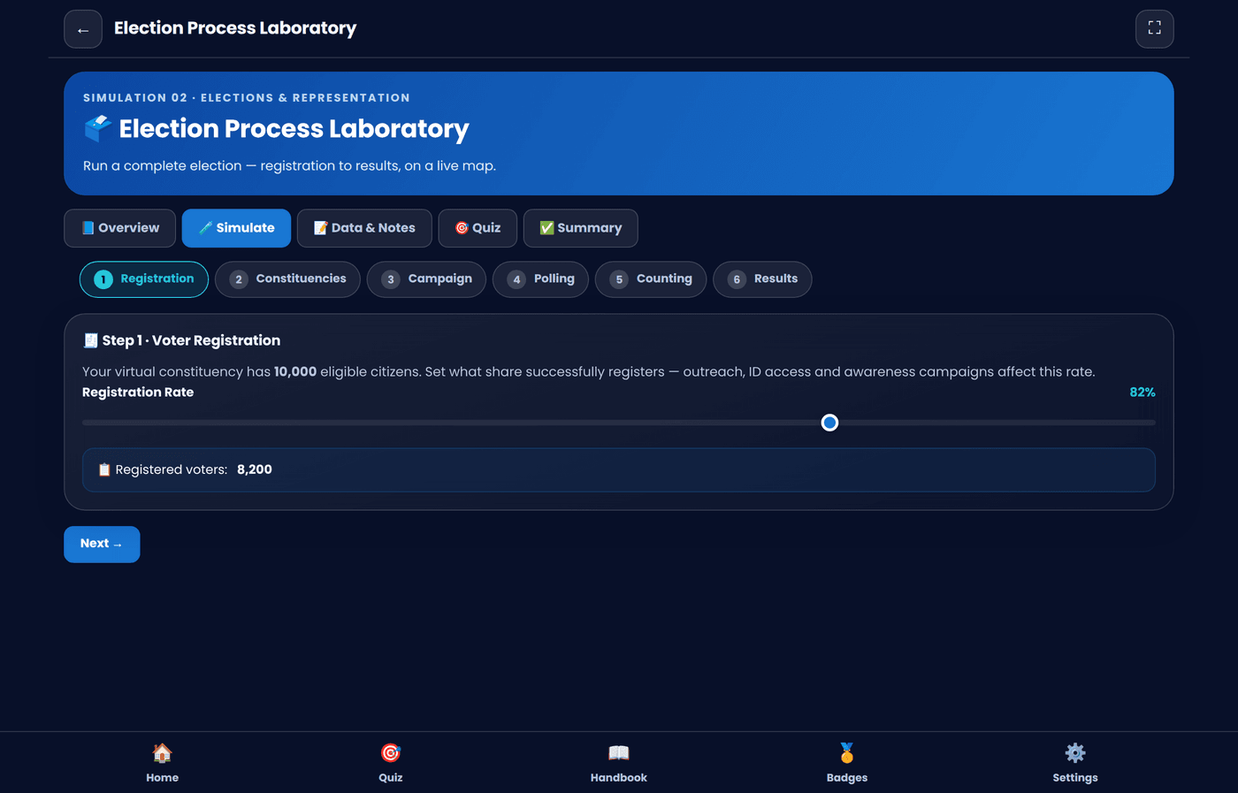
SIMULATION 02 · ELECTIONS & REPRESENTATION
🗳️
Election Process Laboratory
Run a complete election — voter registration all the way to result declaration.
HOW IT WORKS
Set registration rate and delimit constituencies
Allocate campaign strength across 3 competing parties
Hold polling day and watch votes counted live, step by step
Read results on a seat chart and an interactive constituency map
VIRTUAL POLITICAL SCIENCE LABORATORY
07 / 22

Slide 8
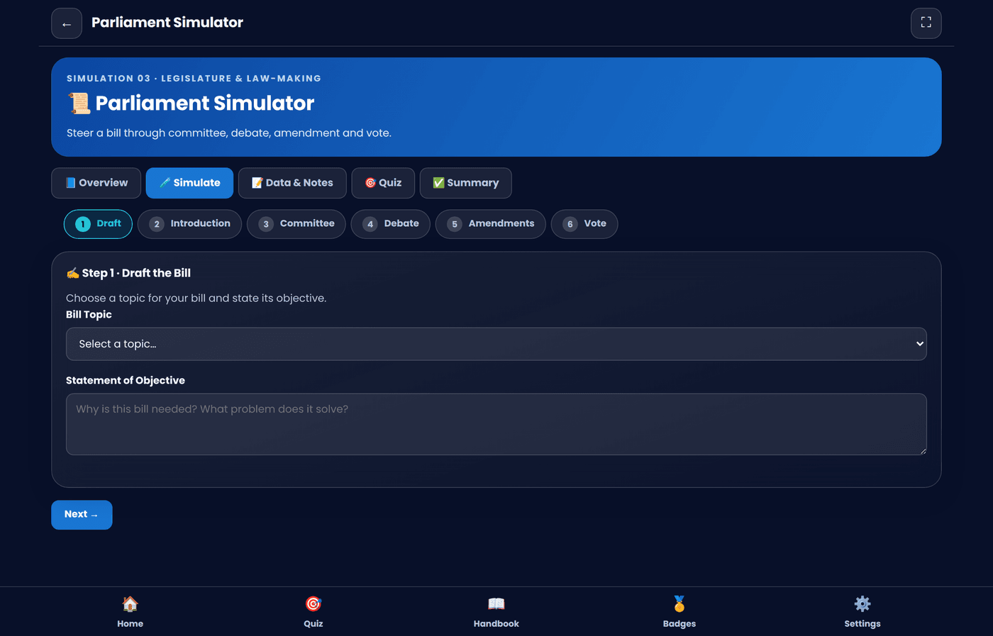
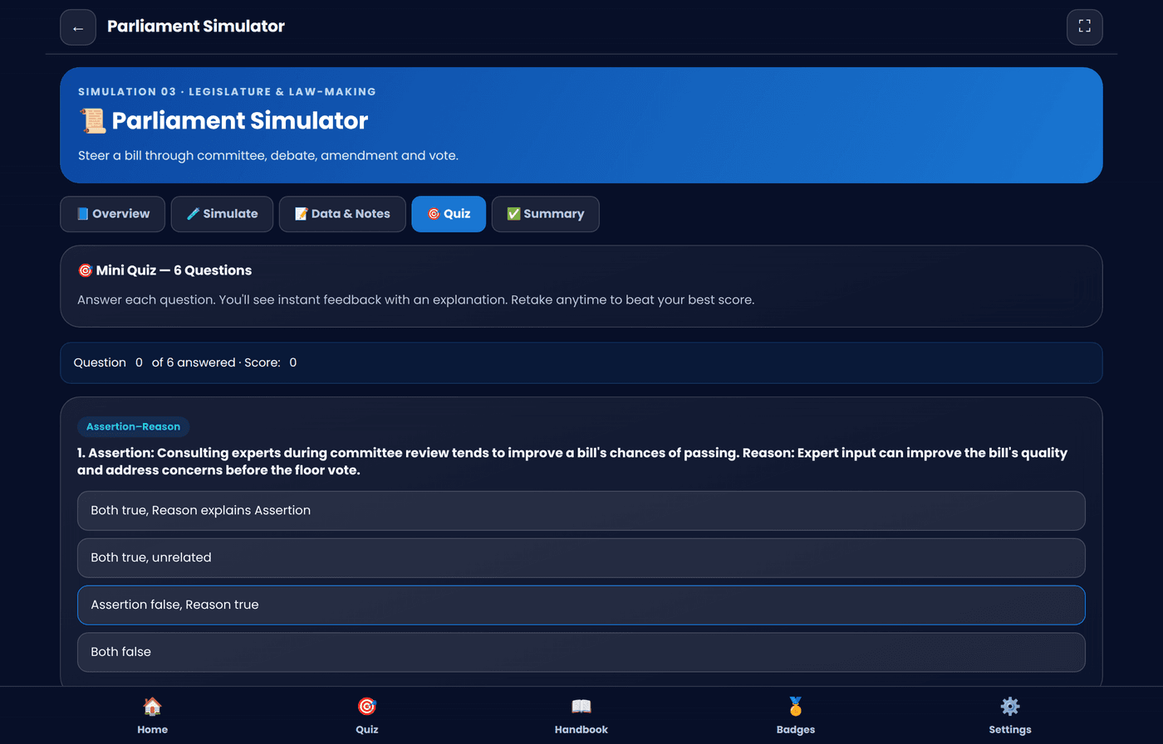
SIMULATION 03 · LEGISLATURE & LAW-MAKING
📜
Parliament Simulator
Steer a bill through committee, floor debate, amendment — and a final vote.
HOW IT WORKS
Draft a bill and state its objective
Send it through committee review — consult experts or rush it
Accept or reject amendments that trade off quality vs. political support
Watch a live division decide whether the bill passes into law
VIRTUAL POLITICAL SCIENCE LABORATORY
08 / 22

Slide 9
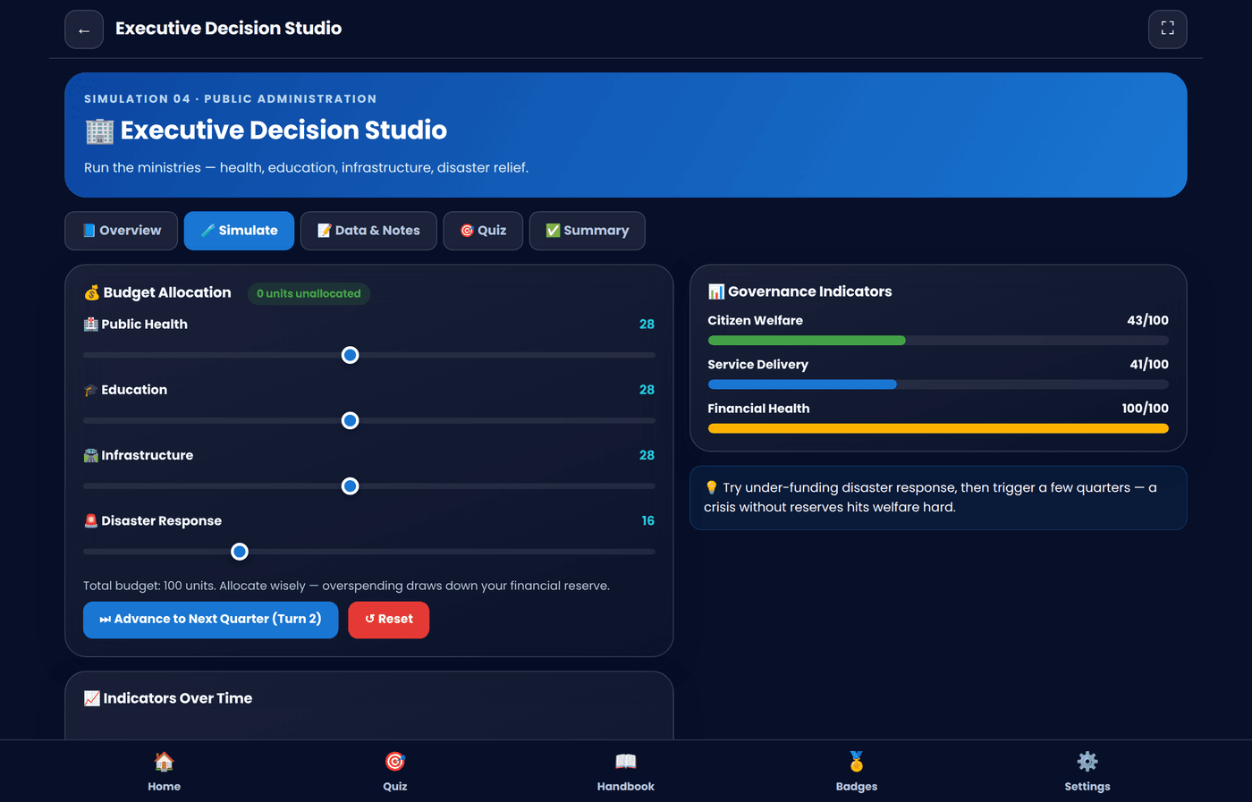
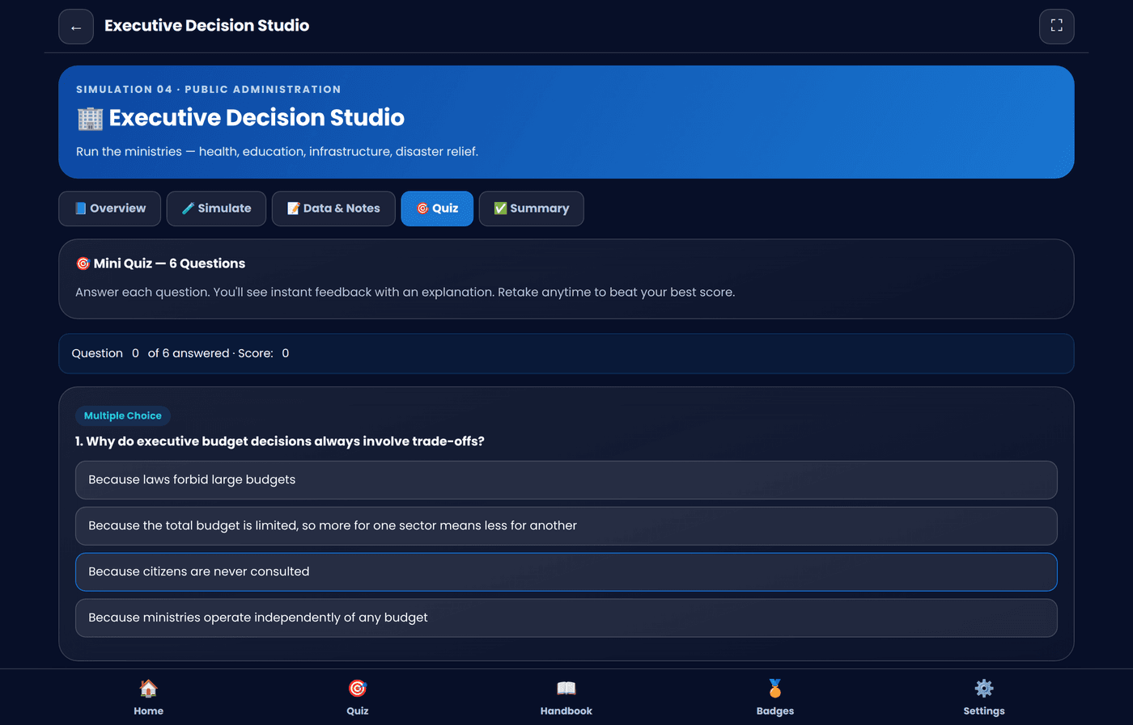
SIMULATION 04 · PUBLIC ADMINISTRATION
🏢
Executive Decision Studio
Run the ministries — health, education, infrastructure and disaster response.
HOW IT WORKS
Allocate a fixed budget across four competing public sectors
Advance quarters and watch welfare, delivery & finances evolve
Respond to random crisis events — floods, outbreaks, transport failure
Track every indicator on a live multi-line trend chart
VIRTUAL POLITICAL SCIENCE LABORATORY
09 / 22

Slide 10
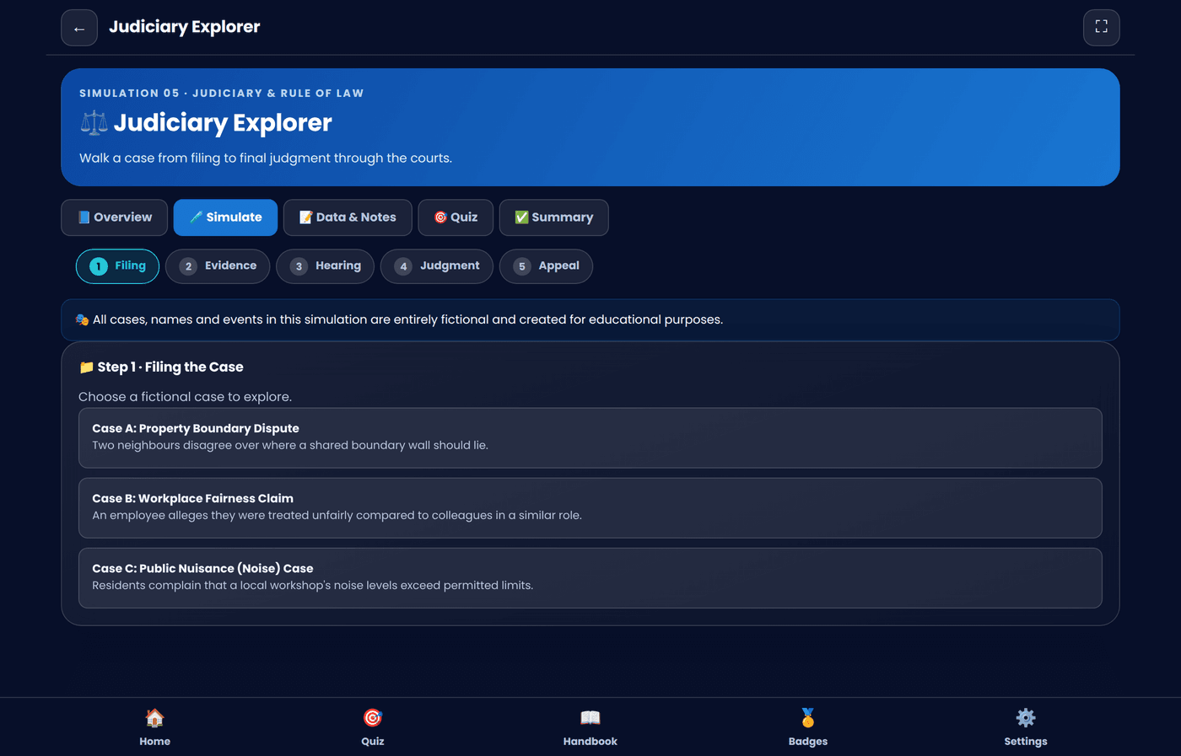
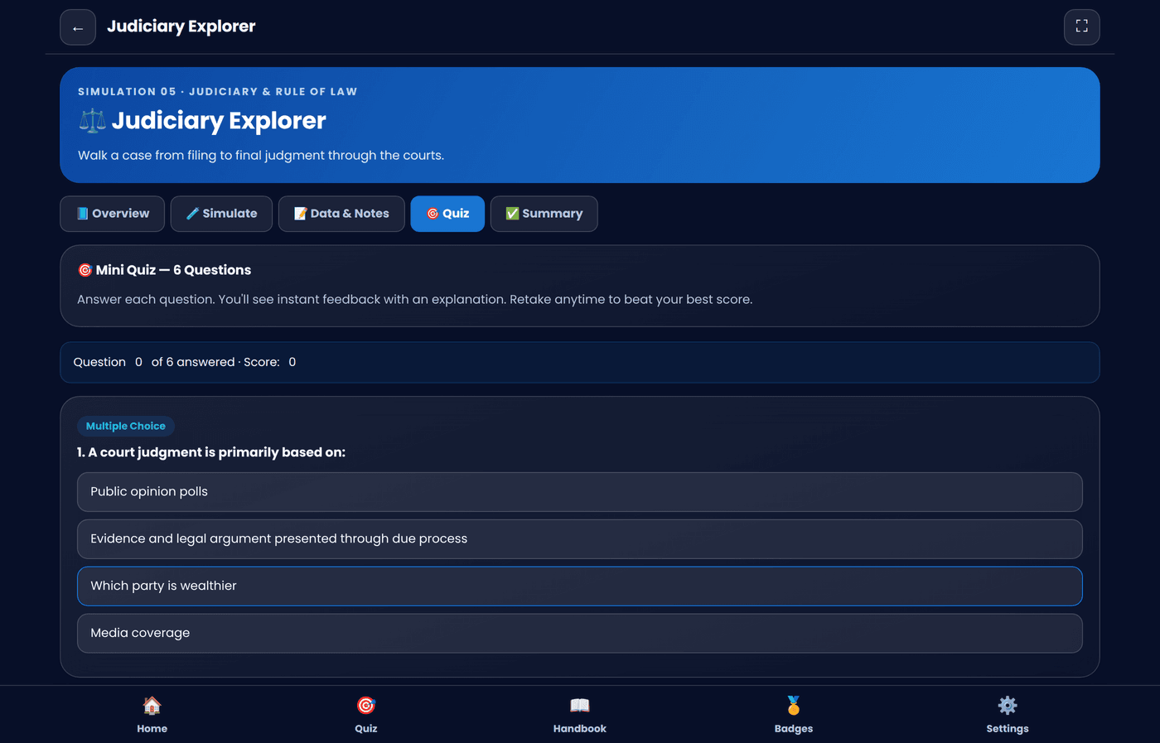
SIMULATION 05 · JUDICIARY & RULE OF LAW
⚖️
Judiciary Explorer
Walk a fictional case from filing to final judgment through the courts.
HOW IT WORKS
Choose a fictional dispute — property, workplace, or public nuisance
Select evidence to present and a hearing strategy
Receive a reasoned judgment based on case strength & due process
File an appeal and see whether a higher court upholds it
VIRTUAL POLITICAL SCIENCE LABORATORY
10 / 22

Slide 11
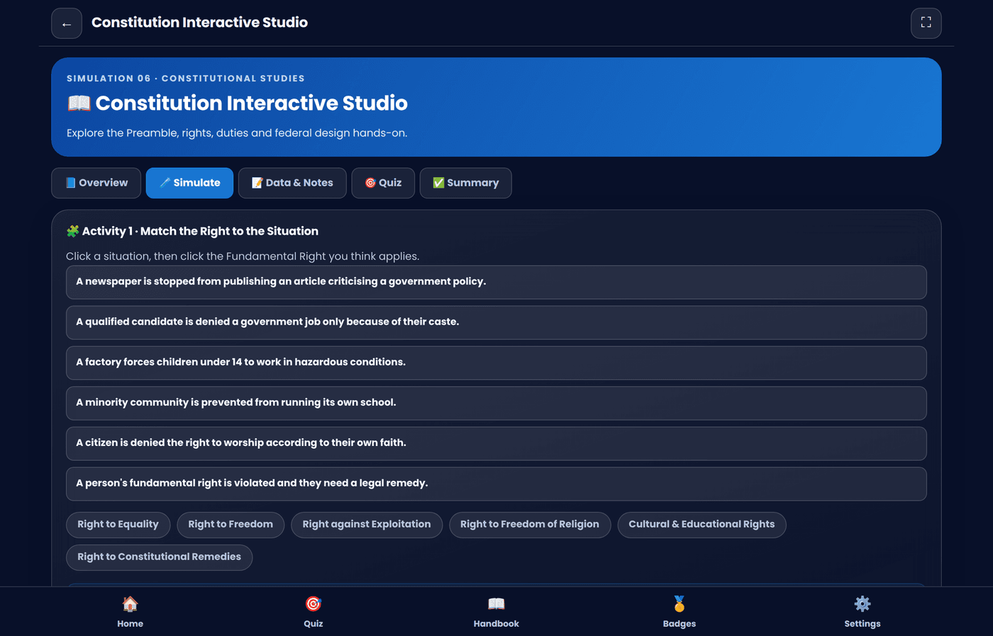
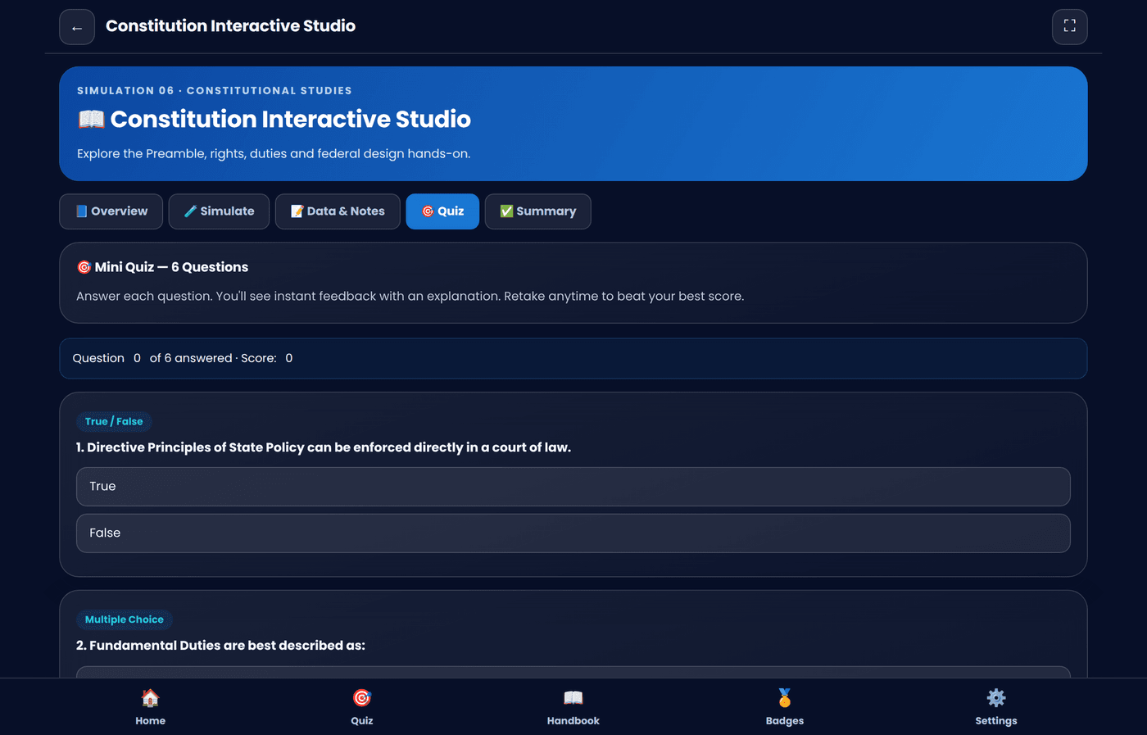
SIMULATION 06 · CONSTITUTIONAL STUDIES
📖
Constitution Interactive Studio
Explore the Preamble, Rights, Duties and federal design hands-on.
HOW IT WORKS
Match everyday situations to the Fundamental Right they involve
Work through short constitutional decision-making dilemmas
Explore the Preamble, Rights, Duties & Federal Structure by theme
Browse an interactive timeline of constitutional milestones
VIRTUAL POLITICAL SCIENCE LABORATORY
11 / 22

Slide 12
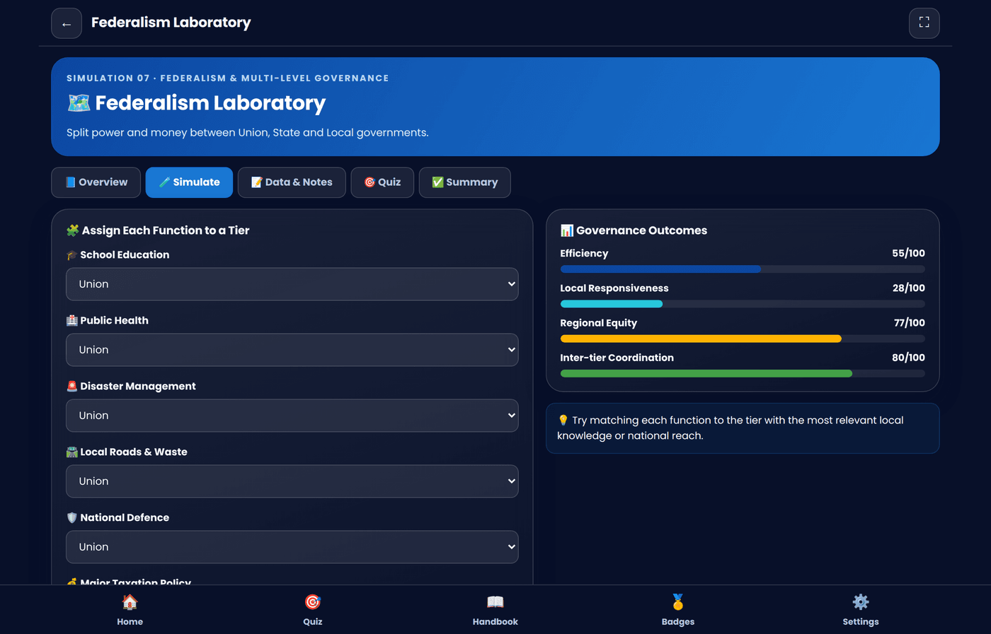
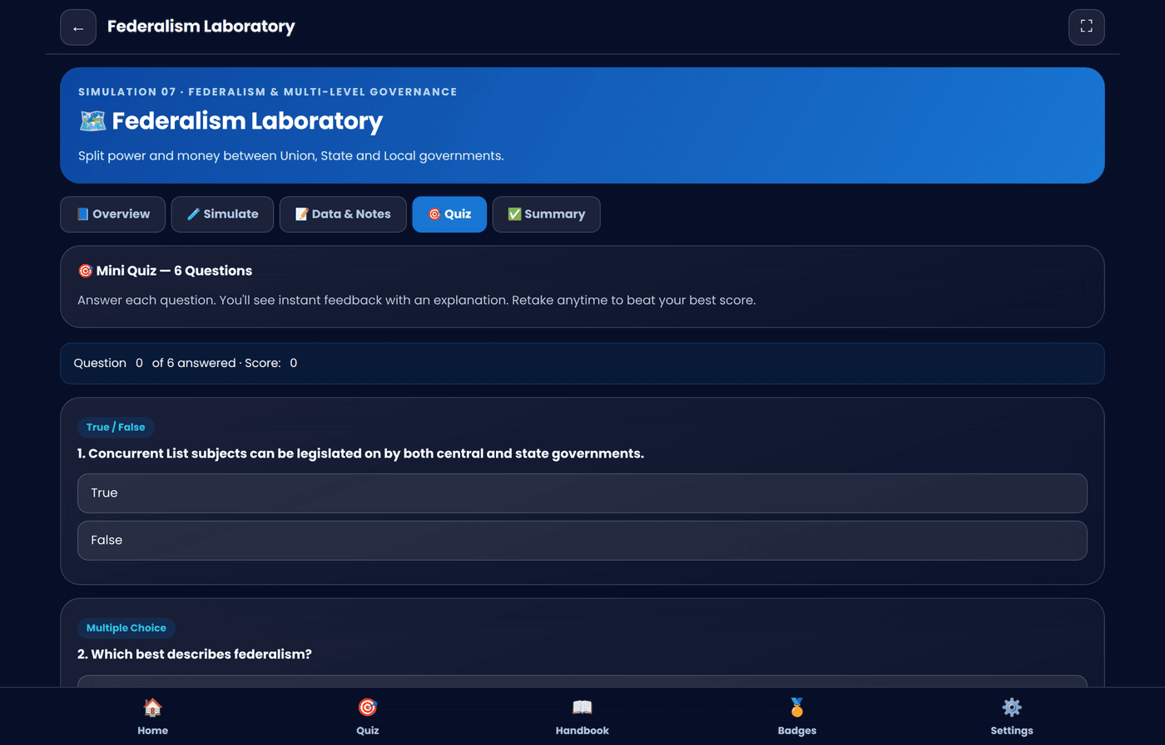
SIMULATION 07 · FEDERALISM & MULTI-LEVEL GOVERNANCE
🗺️
Federalism Laboratory
Split power and money between Union, State and Local governments.
HOW IT WORKS
Assign 6 public functions to Union, State, Local, or Shared tiers
Toggle between Cooperative and Competitive federalism styles
Watch efficiency, responsiveness, equity & coordination scores shift
Discover which tier is genuinely best suited to which function
VIRTUAL POLITICAL SCIENCE LABORATORY
12 / 22

Slide 13
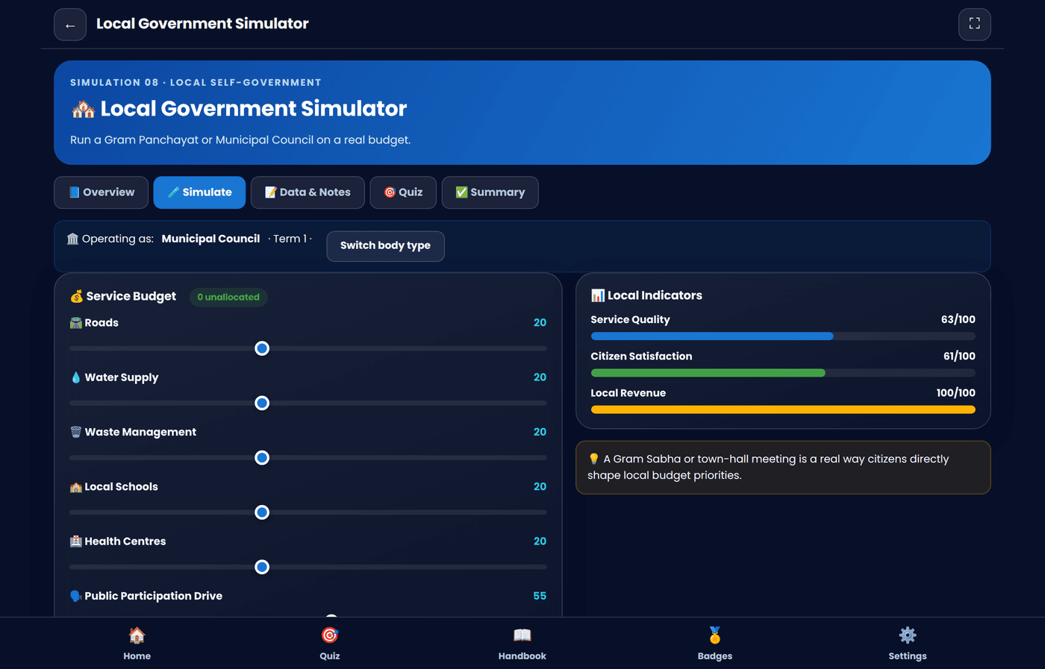
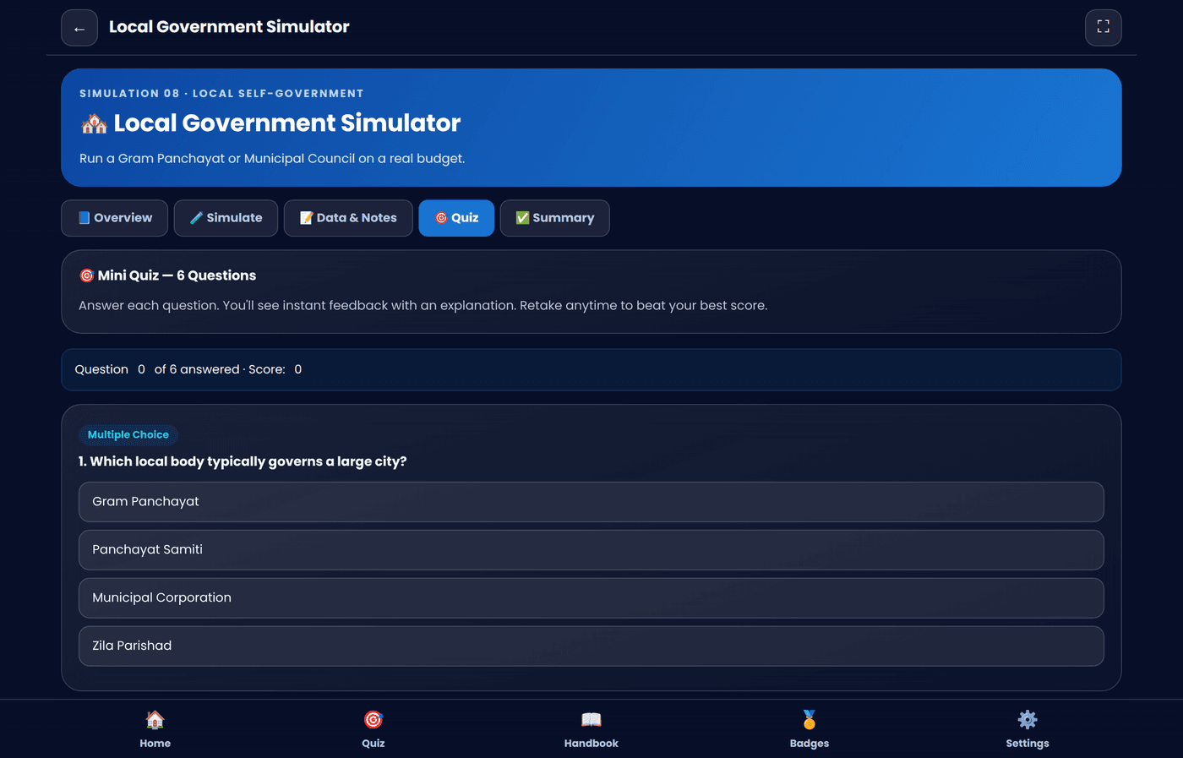
SIMULATION 08 · LOCAL SELF-GOVERNMENT
🏘️
Local Government Simulator
Run a Gram Panchayat, Municipal Council or Corporation on a real budget.
HOW IT WORKS
Choose your local body type and its budget scale
Fund roads, water, waste, schools & health centres
Drive a public-participation lever that lifts revenue & satisfaction
Advance terms and track local indicators over time
VIRTUAL POLITICAL SCIENCE LABORATORY
13 / 22

Slide 14
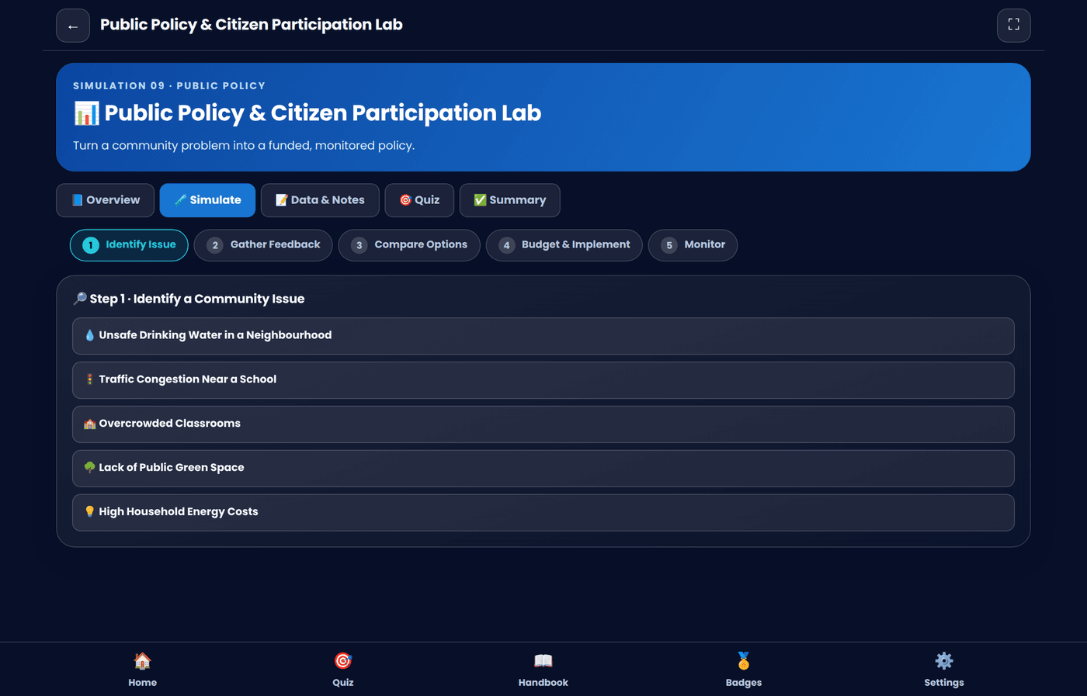
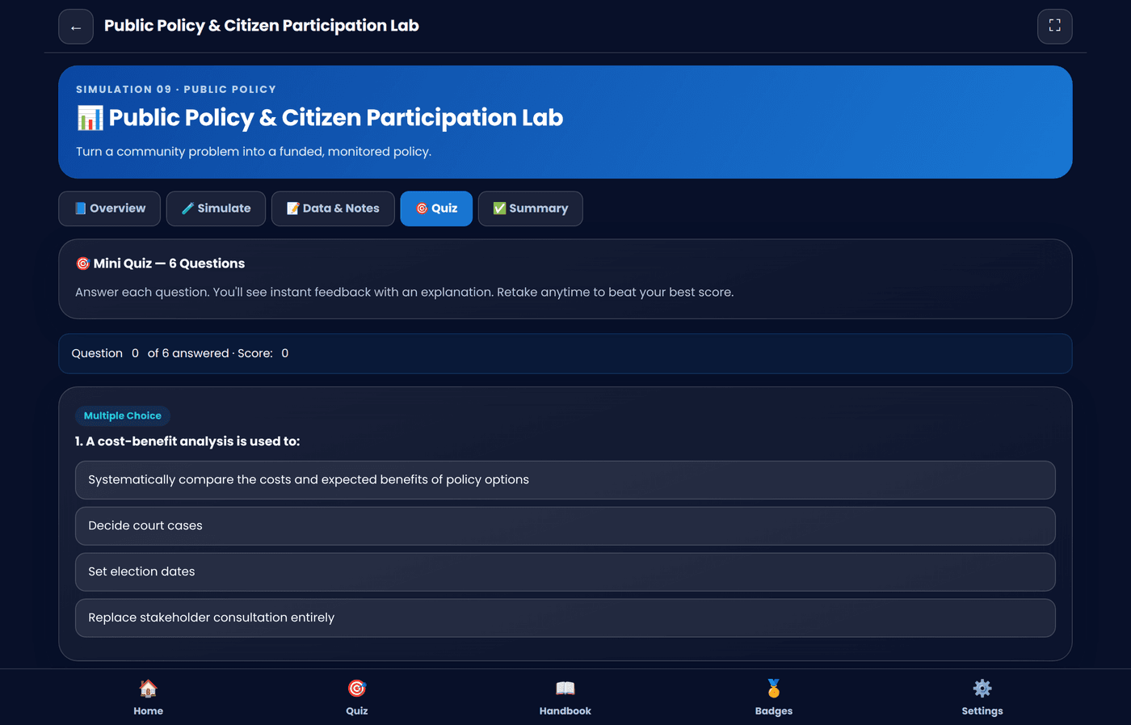
SIMULATION 09 · PUBLIC POLICY
📊
Public Policy & Citizen Participation Lab
Turn a community problem into a funded, monitored public policy.
HOW IT WORKS
Identify a real community issue — water, traffic, schools, parks, energy
Gather feedback from 4 simulated stakeholder groups
Compare policy options on a cost-vs-impact table
Implement your choice and monitor outcomes month by month
VIRTUAL POLITICAL SCIENCE LABORATORY
14 / 22

Slide 15
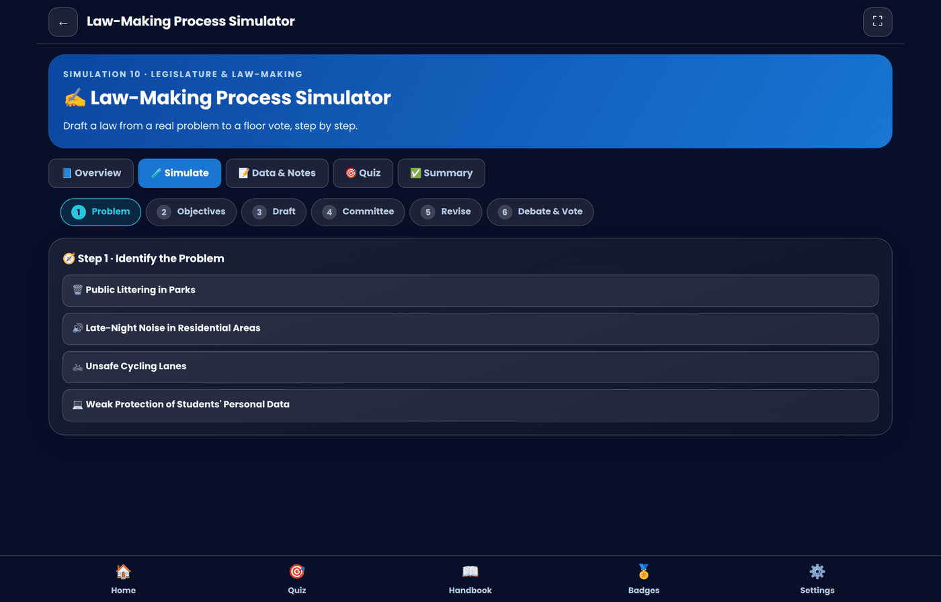
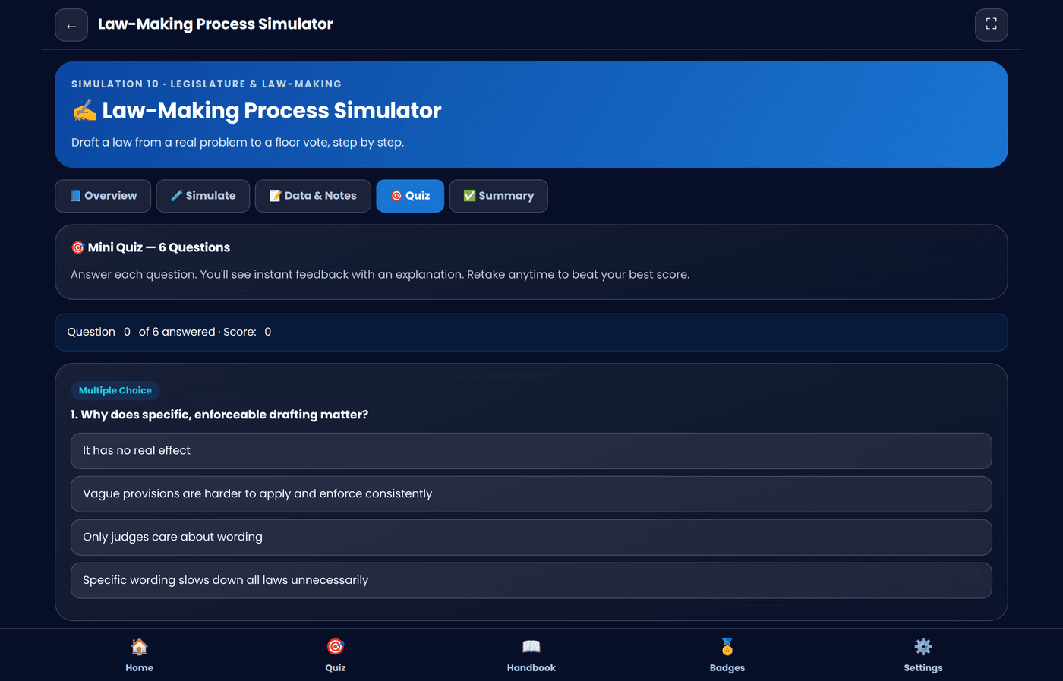
SIMULATION 10 · LEGISLATURE & LAW-MAKING
✍️
Law-Making Process Simulator
Draft a law from a real problem all the way to a floor vote.
HOW IT WORKS
Identify a problem and define clear legislative objectives
Draft provisions and receive committee feedback on weaknesses
Revise the bill in light of that feedback before it's finalised
Present it for debate and a final vote — pass or redraft
VIRTUAL POLITICAL SCIENCE LABORATORY
15 / 22

Slide 16
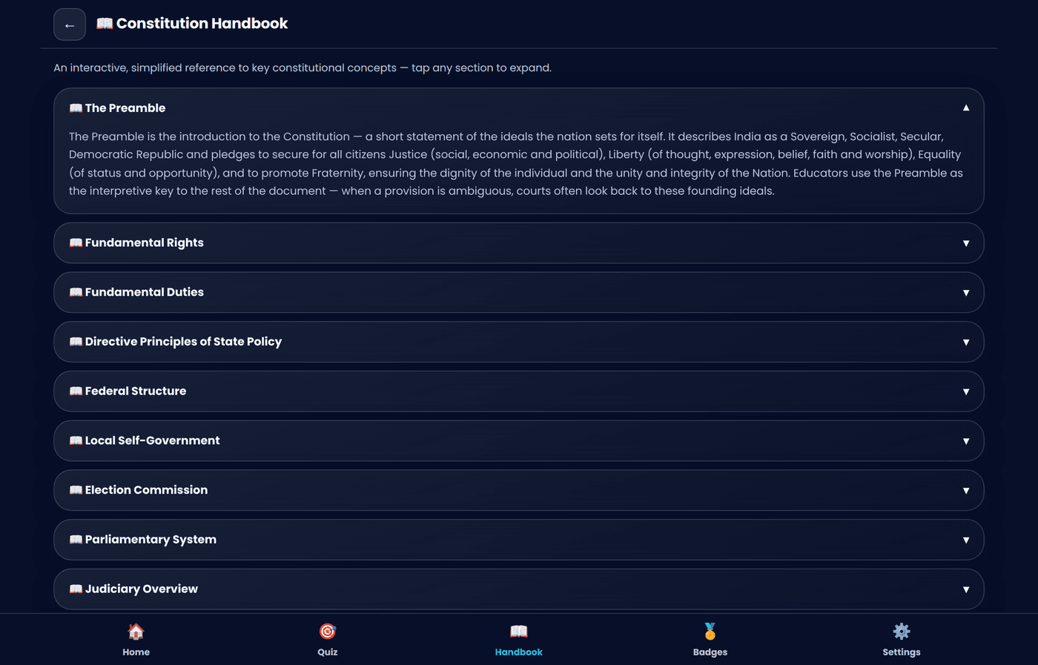
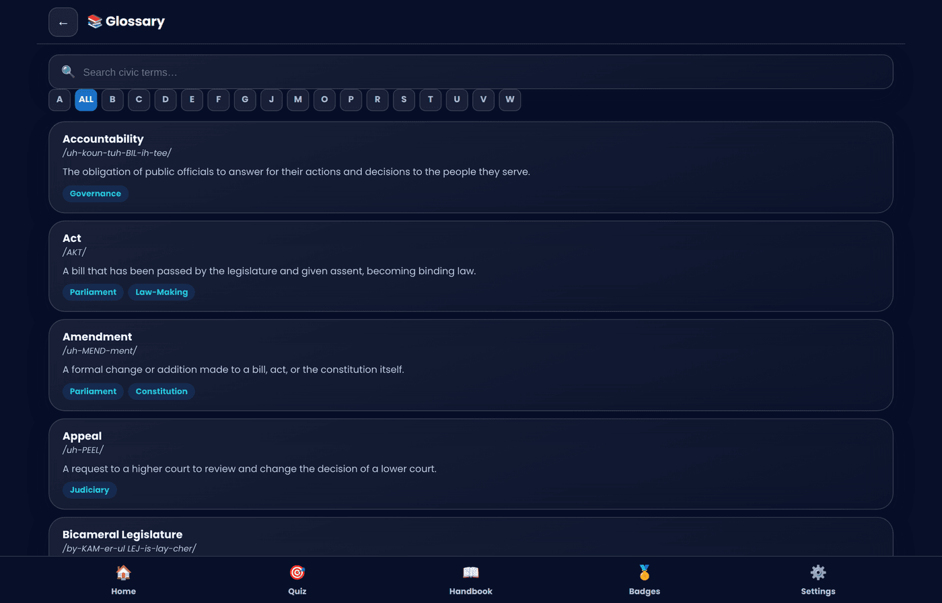
BUILT-IN REFERENCE LIBRARY
Constitution Handbook & Glossary
Two always-available references support every simulation — no need to leave the app to look something up.
📖 CONSTITUTION HANDBOOK
10 expandable sections: Preamble, Rights, Duties, Directive Principles, Federal Structure, Local Self-Government, Election Commission, Parliamentary System, Judiciary, Amendments
Simplified, school-appropriate explanations for every concept
Tap any section to expand — no scrolling through a wall of text
📚 GLOSSARY
40 illustrated civic terms with pronunciation guides and topic tags
Searchable, and browsable alphabetically from A–Z
Every term links conceptually back to the simulations
VIRTUAL POLITICAL SCIENCE LABORATORY
16 / 22

Slide 17
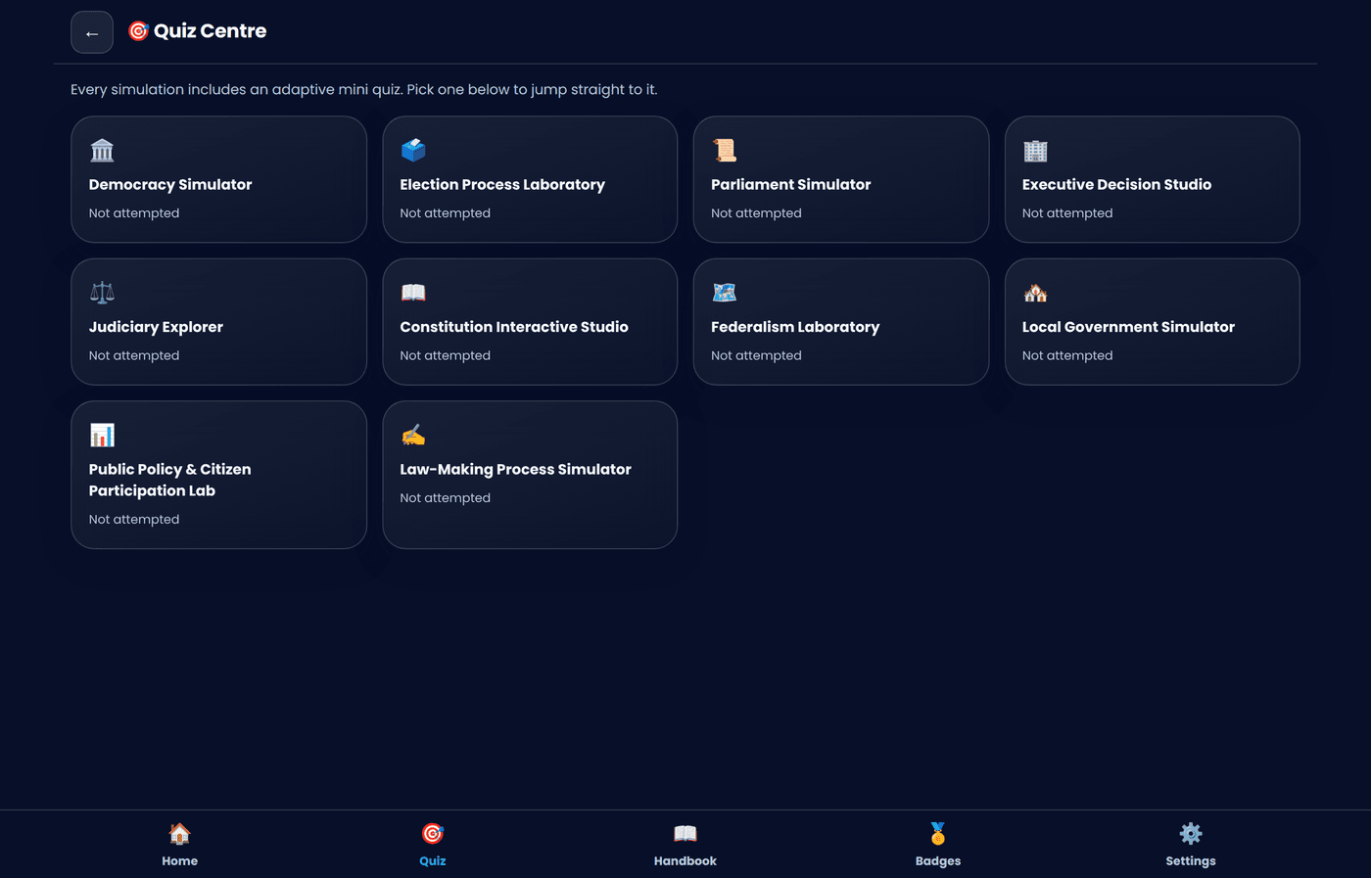
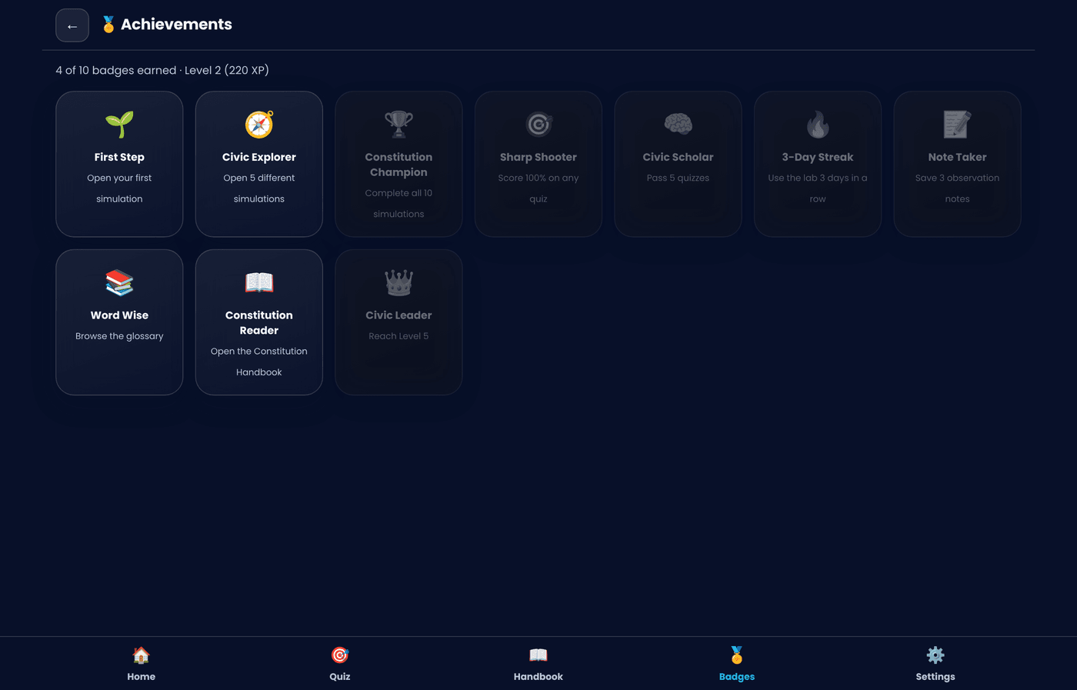
MOTIVATION & MASTERY
Quiz Centre & Gamification
Every simulation feeds a shared system of XP, civic levels and badges that keeps students coming back.
🎯 QUIZ CENTRE
One hub listing all 10 simulations and your best score on each
Tap any card to jump straight into that simulation's quiz
Questions shuffle on every retake — MCQ, True/False & Assertion–Reason
Instant feedback with a plain-language explanation for every answer
🏅 XP, LEVELS & BADGES
6 civic levels, from “Citizen-in-Training” to “Constitution Champion”
10 collectible badges — Civic Explorer, Sharp Shooter, Word Wise & more
Daily-use streak counter to build a civic-learning habit
VIRTUAL POLITICAL SCIENCE LABORATORY
17 / 22

Slide 18
TRUST & ACCESSIBILITY
Settings, Offline Mode & Privacy
Everything runs and saves entirely on the student's own device — nothing is sent anywhere.
📡
🔒
🌓
100% Offline
No Login, No Cloud
Light & Dark Themes
A full Progressive Web App with a service worker — installs once, works forever without internet.
All XP, notes, quiz scores and settings are saved with local browser storage only.
Switch instantly to match classroom lighting or personal preference.
👩‍🏫
📤
♿
Teacher Mode
Export Notes
Accessible by Design
Reveals facilitator notes and answer-key context for classroom use.
Download all saved observation notes as a plain text file anytime.
Reduce-motion setting, high-contrast palette, and responsive layouts for all screen sizes.
VIRTUAL POLITICAL SCIENCE LABORATORY
18 / 22

Slide 19
WHY IT WORKS
Pedagogical Framework
Every design decision traces back to a specific learning principle — not novelty for its own sake.
🧭
Inquiry-Based Learning
Students form a hypothesis, adjust variables, and observe real consequences — instead of memorising a fact.
🧩
Competency-Based Learning
Each simulation targets a specific civic competency: evidence-based reasoning, negotiation, or ethical decision-making.
🎓
NEP 2020 Alignment
Experiential, activity-based learning replaces rote instruction, matching the National Education Policy's core direction.
📢
Responsible Citizenship
By simulating consequences, students build the judgement to participate constructively in real civic life.
VIRTUAL POLITICAL SCIENCE LABORATORY
19 / 22

Slide 20
ABOUT THE DEVELOPER
Dr. Mateen Yousuf
Teacher · School Education Department, Kashmir
🎯 VISION
Help students experience democracy and governance rather than just read about them
Build constitutional literacy, critical thinking and responsible citizenship through hands-on simulation
Deliver a genuinely production-ready, offline-first tool usable in any classroom, connected or not
Dr. Mateen Yousuf
Teacher, School Education
Department, Kashmir
📐 DESIGN PRINCIPLES
Inquiry-based, competency-based learning aligned with NEP 2020
Every module is a genuine simulation — never a static slideshow
100% offline, installable, and accessible on low-end devices
“Building constitutional literacy
one simulation at a time.”
VIRTUAL POLITICAL SCIENCE LABORATORY
20 / 22

Slide 21
AT A GLANCE
All 10 Simulations
A complete civic curriculum in one offline laboratory.
01
02
03
04
05
🏛️
🗳️
📜
🏢
⚖️
Democracy Simulator
Election Process Laboratory
Parliament Simulator
Executive Decision Studio
Judiciary Explorer
06
07
08
09
10
📖
🗺️
🏘️
📊
✍️
Constitution Interactive Studio
Federalism Laboratory
Local Government Simulator
Public Policy & Citizen Participation Lab
Law-Making Process Simulator
VIRTUAL POLITICAL SCIENCE LABORATORY
21 / 22

Slide 22
VIRTUAL POLITICAL SCIENCE LABORATORY
Democracy is better understood
by doing than by reading.
Ten simulations. Zero internet required. Explore the full laboratory today.
🏛️ Enter the Laboratory
Created by Dr. Mateen Yousuf · Teacher, School Education Department, Kashmir
VIRTUAL POLITICAL SCIENCE LABORATORY
22 / 22

